Slide 1
Data Science Engineering Methods and Tools Lecture 11
Northeastern University
College of Engineering
INFO 6105 – Spring 2024
Abdolreza Mosaddegh

Slide 2
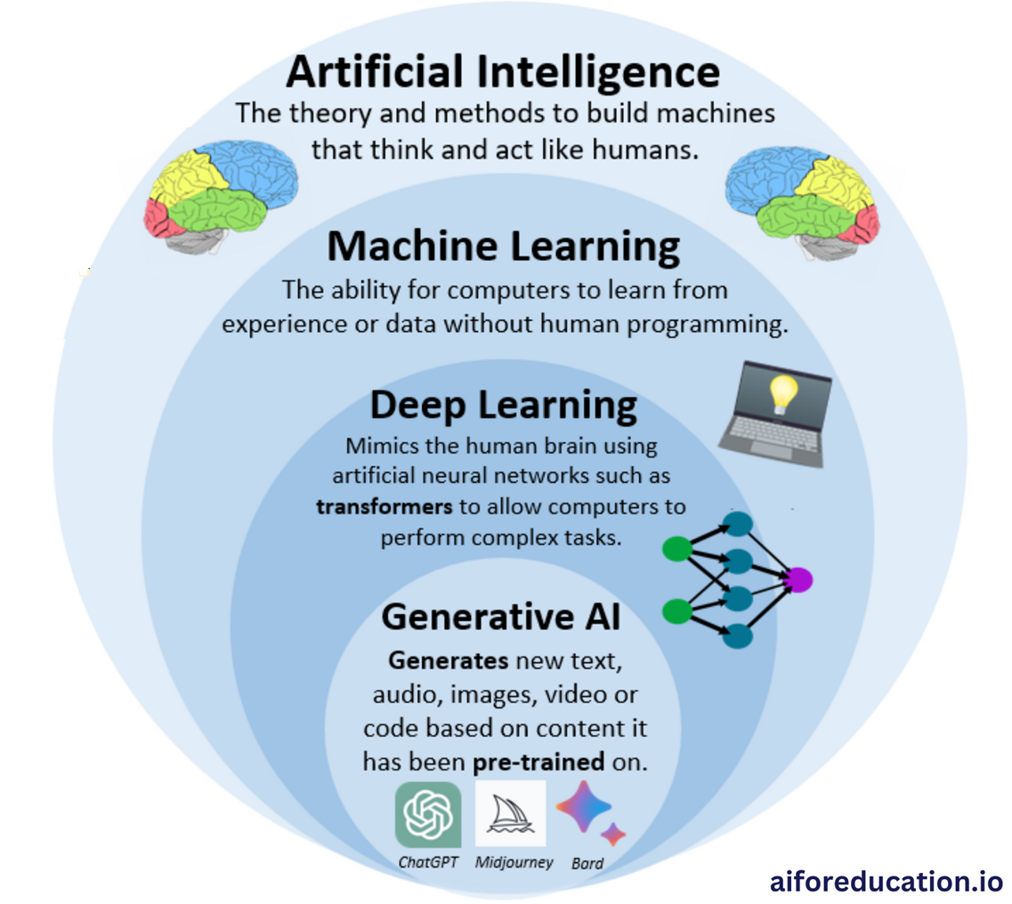
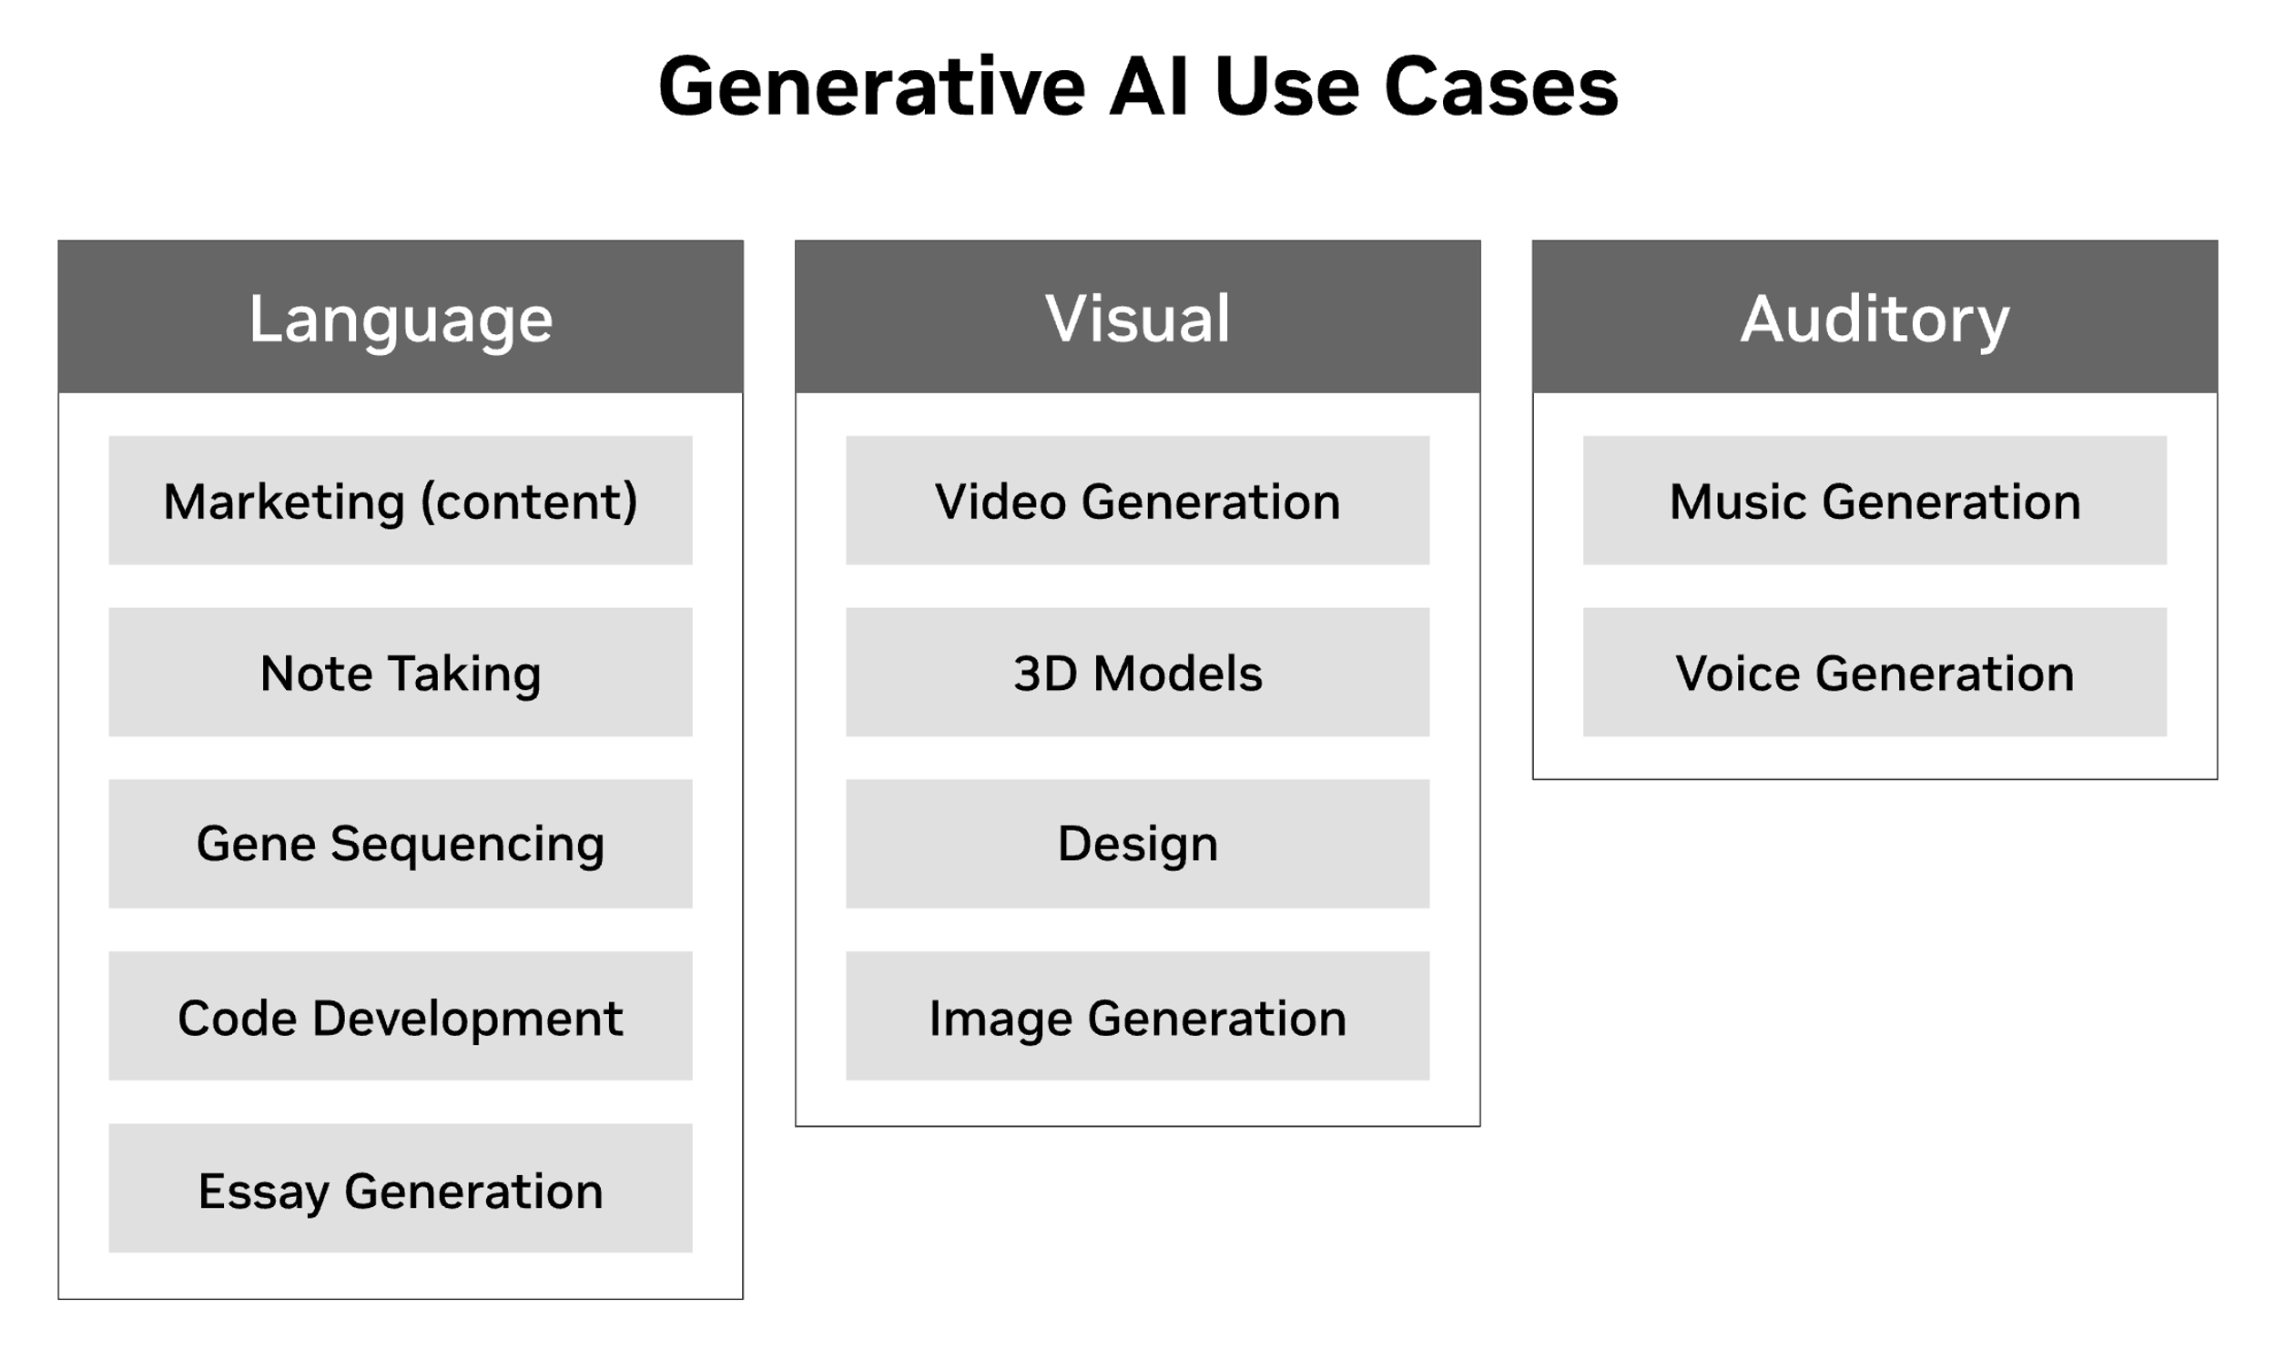
Generative AI
Generative AI is a type of artificial intelligence technology that can produce various types of content, including text, image, video, audio and synthetic data.

Slide 3
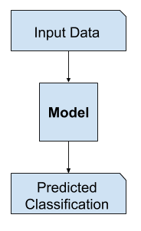
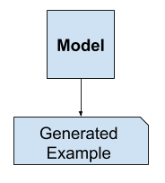
Discriminative vs. Generative Modeling
In supervised learning, classification is also traditionally referred to as discriminative modeling, since we use the training data to find a discriminant function that maps features directly onto a class label
Approaches that explicitly or implicitly model the distribution of inputs as well as outputs are known as generative models, because by sampling from them it is possible to generate synthetic data points in the input space
Generative and discriminative model can be combined to create more complex models

Slide 4
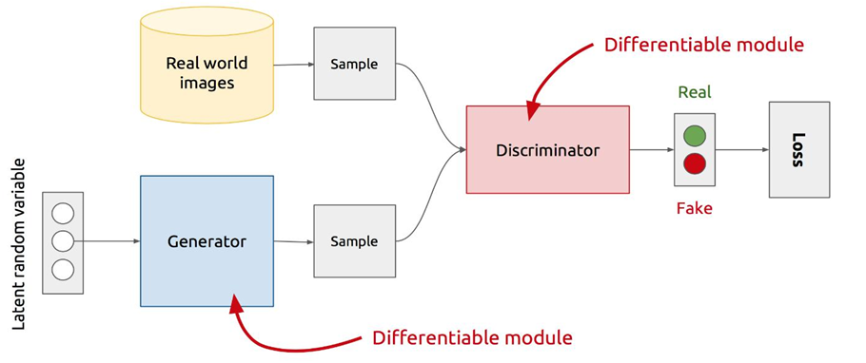
Generative Adversarial Network (GAN)
Generative Adversarial Networks are an approach to generative modeling using deep learning methods, such as convolutional neural networks. A generative adversarial network (GAN) has two competing models in a zero-sum game :
The generator learns to generate plausible fake data.
The discriminator learns to distinguish the generator's fake data from real data.

Slide 5
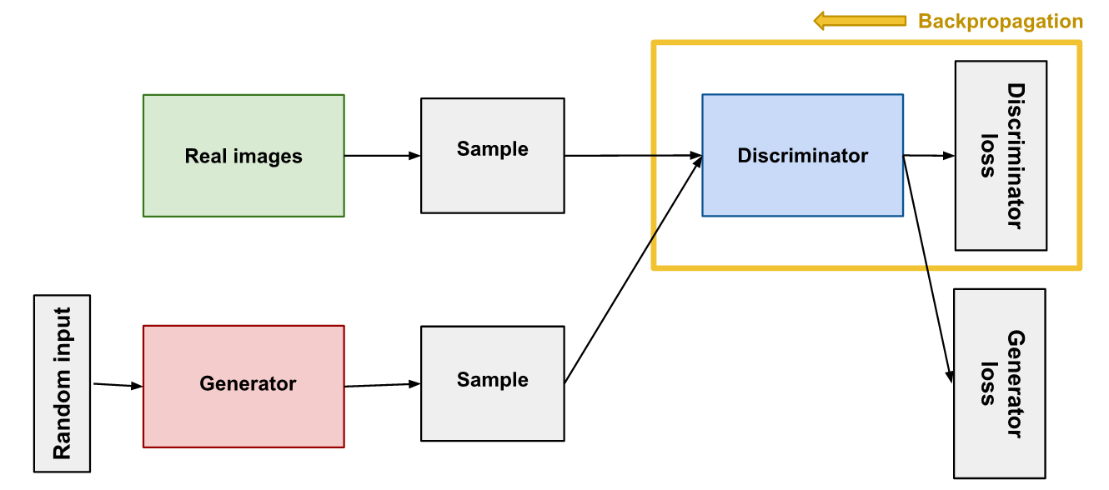
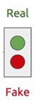
Discriminator
The discriminator in a GAN is simply a classifier. It tries to distinguish real data from the data created by the generator (fake). It could use any network architecture appropriate to the type of data it's classifying (e.g., CNN for images).
Training Data: Real data samples besides fake data samples generated by the generator.
Loss Function : The discriminator calculates the discriminator loss based on its ability to correctly classify real and fake data.
Backpropagation: Update the weights of the discriminator using gradient decent to minimize discriminator loss, thus improving its ability to distinguish between real and fake samples.
CNN

Slide 6
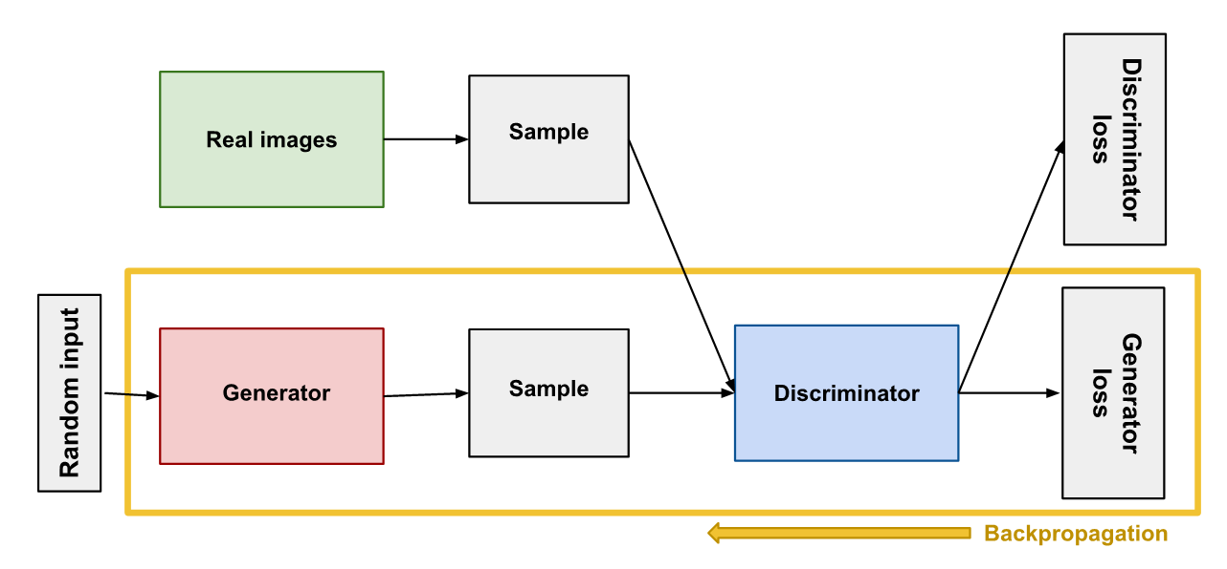
Generator
The generator part of a GAN learns to create fake data by incorporating feedback from the discriminator. It learns to make the discriminator classify its output as real.
Training Data: it takes random input (noise) as input and generates fake data samples.
Loss Function : The generator's loss (error) is calculated based on how well the discriminator was fooled. The goal is to generate samples that the discriminator is more likely to classify as real.
Backpropagation: Update the weights of the generator using gradient decent to minimize generator loss (maximize classification loss), thus improving its ability to generate more realistic samples.

Slide 7
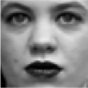
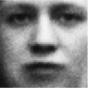
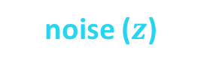
Training Process
Training process as a game between generator and a discriminative networks:
Generator tries to fool Discriminator
Discriminator tries not to be fooled
Models are trained together
As Generator gets better, Discriminator has a more challenging task
As Discriminator gets better, Generator has a more challenging task
During this competition both model get stronger
Ultimately, the discriminator model is not important
(Its role is to force generator to work harder)
real or fake?
Discriminative Model
Real world
noise ($z$)
Generative Model

Slide 8

Training Steps
GAN training proceeds in alternating periods:
The discriminator trains for one or more epochs to minimize classification loss.
The generator trains for one or more epochs to maximize classification loss.
The generator and discriminator training is repeated till a stopping criterion is met.
Every time the discriminator notices a difference between the two distributions the generator adjusts its parameters slightly to make it go away, until at the end (in theory) the generator exactly reproduces the true data distribution, and the discriminator is guessing at random (50%), unable to find a difference.

Slide 9
Loss Function
GAN needs two loss functions: one for generator training and one for discriminator training. Both can be in realized Minimax Loss function:
the generator tries to minimize the Minimax function while the discriminator tries to maximize it:
The generator can't directly affect the log(D(x)) in the function, so, for the generator, minimizing the loss is equivalent to minimizing log(1 - D(G(z))).
E_{x} [log D(x)] + E_{z} [log(1-D(G(z)))]
D(x) is the discriminator's estimate of the probability that real data instance x is real.
Ex is the expected value over all real data instances.
G(z) is the generator's output when given noise z.
D(G(z)) is the discriminator's estimate of the probability that a fake instance is real.
Ez is the expected value over all generated fake instances.
The formula derives from the cross-entropy between the real and generated distributions.
The expected value is the mean of the possible values a random variable can take, weighted by the probability of those outcome

Slide 10
Self-supervised Learning
GANs are considered as self-supervised methods.
They use the unlabeled data as the training set and label it as real.
This methods can be considered unsupervised learning, since no human-annotated data is needed for training.
Unlabeled Real Images as

Slide 11
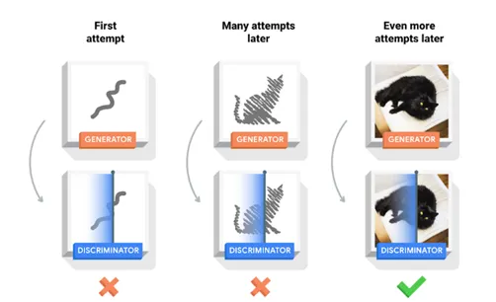
Training Considerations
We keep the generator constant during the discriminator training phase. As discriminator training tries to figure out how to distinguish real data from fake, it has to learn how to recognize the generator's flaws.
We also keep the discriminator constant during the generator training phase. Otherwise, the generator would be trying to hit a moving target and might never converge.
May want multiple training epochs of just discriminator so it can stay ahead
May want multiple training epochs of just generator because it has a harder task

Slide 12
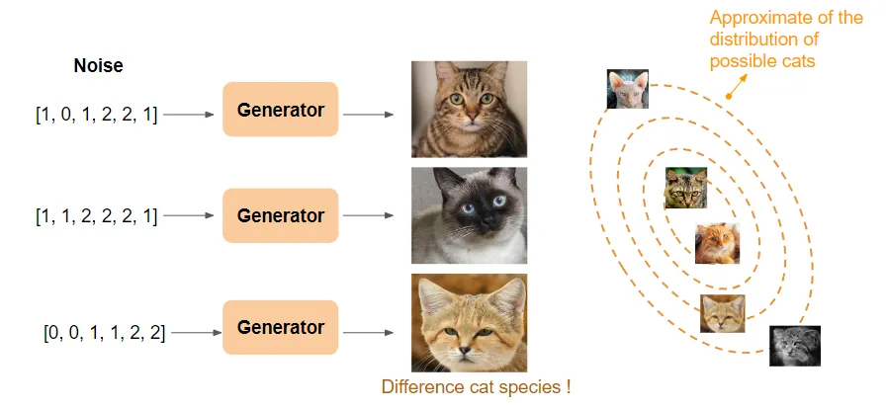
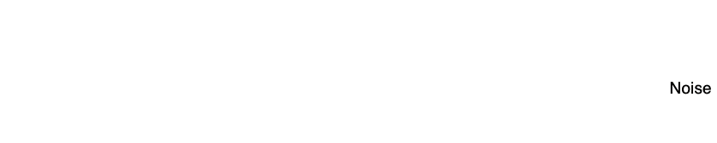
Noise
Noise is a random small number vector.
The generator transforms this noise into a meaningful output.
By introducing noise, we can get the GAN to produce a wide variety of data (images) in the target distribution (target class).

Slide 13
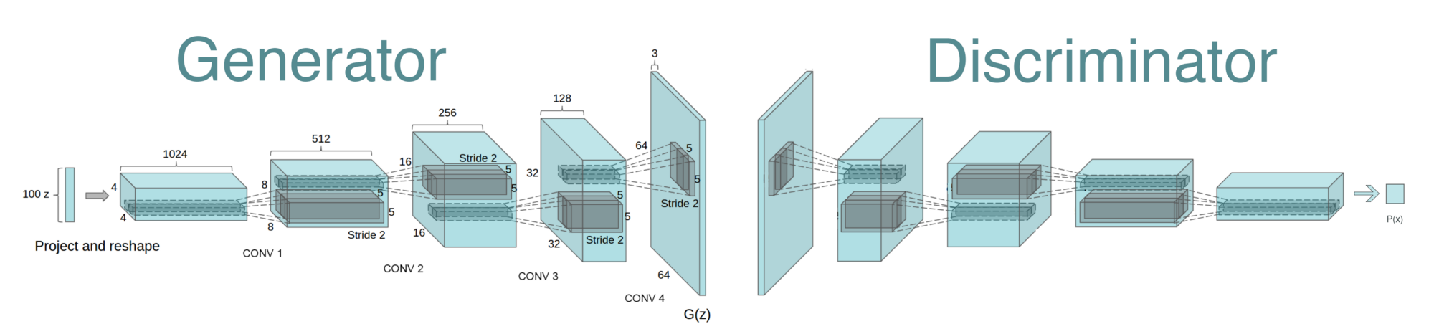
Layers of Generative Adversarial Network
The space from which the noise is sampled is usually of smaller dimension than the dimensionality of the output space.
To change noise input to an image can be fed to discriminator, transposed convolutional layers can be used
Transposed convolution
(Deconvolution)
Classifier (CNN)

Slide 14



Transpose Convolutional Layer
A transposed convolutional layer, is usually carried out for up-sampling using zero padding to generate an output feature map that has a spatial dimension greater than that of the input feature map.
The kernels (weights) are learned during training (backpropagation).
Convolution
Transpose Convolution
Output
Output
Input
Input

Slide 15
GAN - Example
Transposed conv
Tanh/Sigmoid
Conv,
LReLU
Conv,
LReLU
Reshape,
FC,
LReLU
FC,
Reshape
Transposed conv
ReLU
FC,
Sigmoid
A random vector
100
7x7x16
14x14x8
28x28x1
14x14x8
7x7x16
256
1
Generator
Discriminator (CNN)

Slide 16
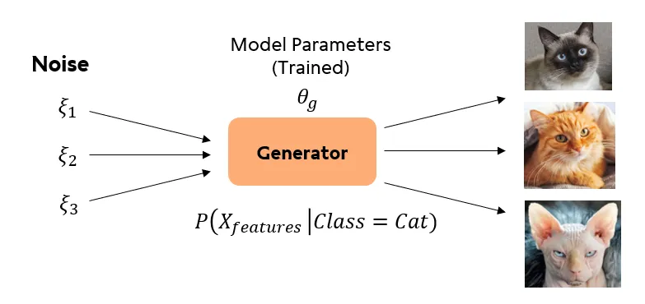
GAN - Inference
After we done training process, we will use only generator model to do inference.
Generator will generate realistic images using random inputs (noise vector) on selected class that GAN model is trained on (e.g., cat / dog)

Slide 17
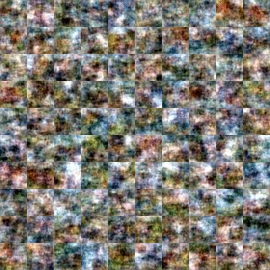
GAN - Considerations
GAN network usually contains large number of parameters. Advanced models usually have about 100 million parameters.
The GAN can be slow to train, particularly when there are a large number of training images.
Transfer learning techniques and fine-tuning can be used on GANs to facilitate training process.
Using dropout is also recommended, since it makes the GAN learns to generate images with generalizable patterns rather than memorizing the training set (overfitting).

Slide 18
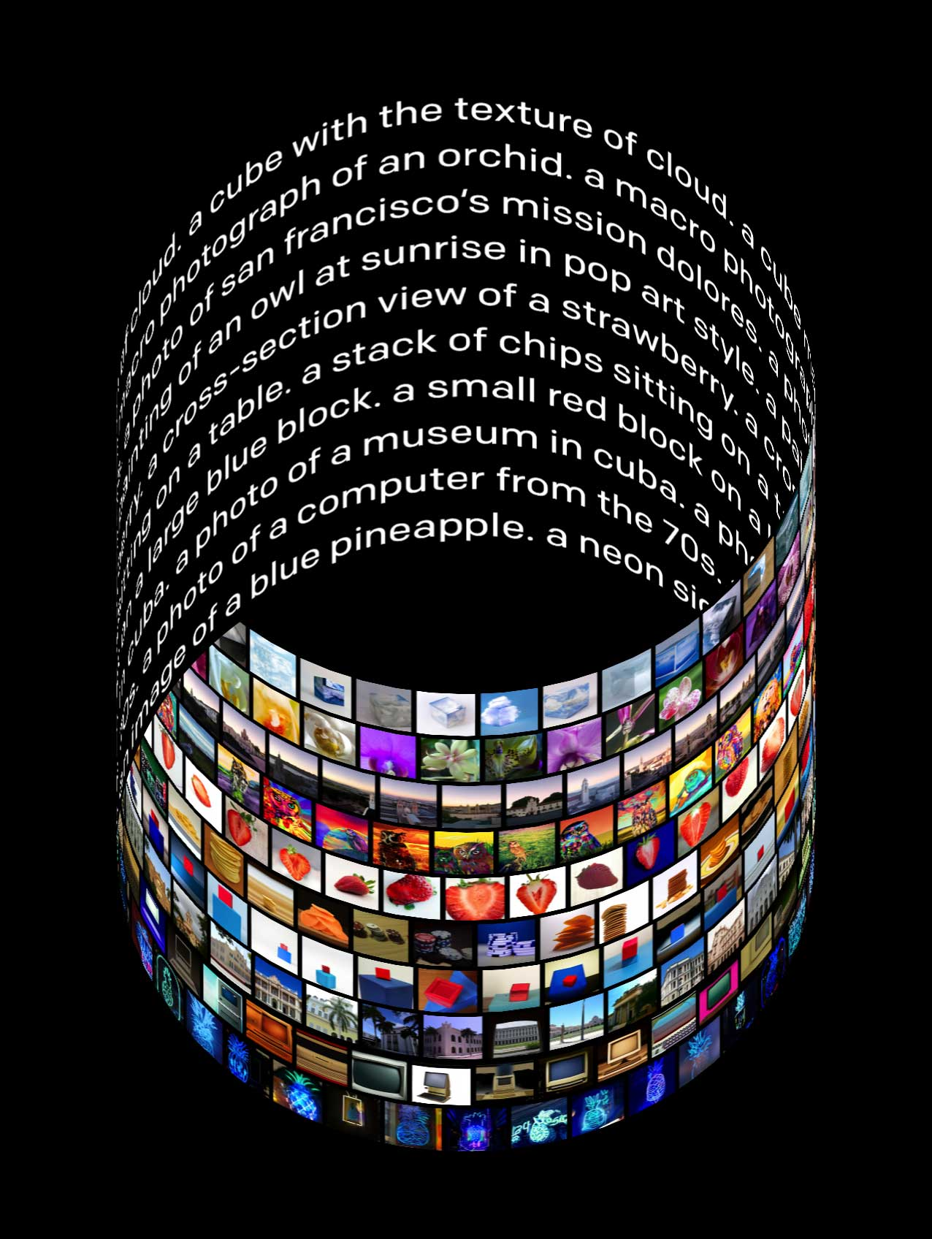
GAN-based Tools - Example
DALL-E and MidJourney are two examples of generative AI tools create images based on textual descriptions.
These networks process textual input and encode it into a latent vector. This vector serves as the foundation for image generation.
They employ customized generative adversarial network (GAN) architectures to generate images.

Slide 19
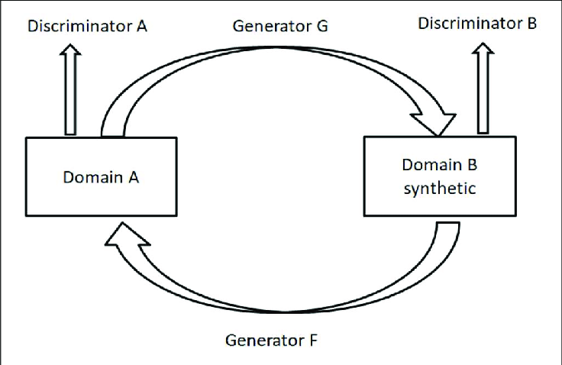
Cycle GAN
The Cycle GAN uses two generative adversarial networks (GANs) to learn the mapping between two domains of images. The model is trained to capture the characteristics of the target domain and to generate new images from the source domain that share the same characteristics.
One generator takes images from the first domain as input and outputs images for the second domain, and the other generator takes images from the second domain as input and generates images for the first domain.
Discriminator models are then used to determine how plausible the generated images are and update the generator models accordingly.

Slide 20
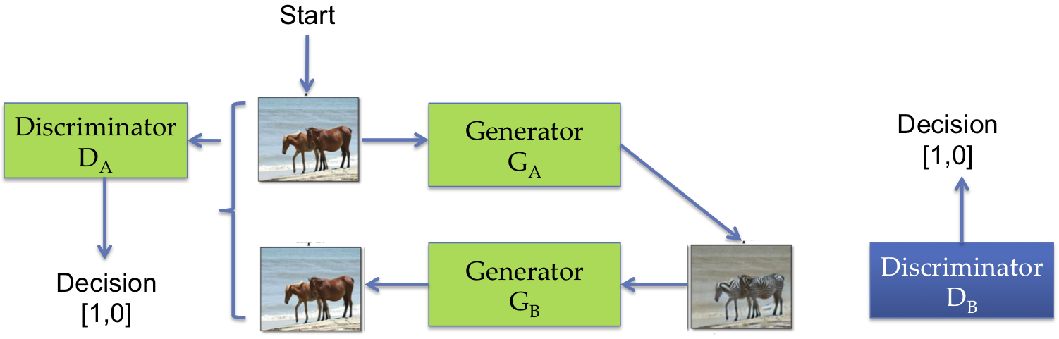
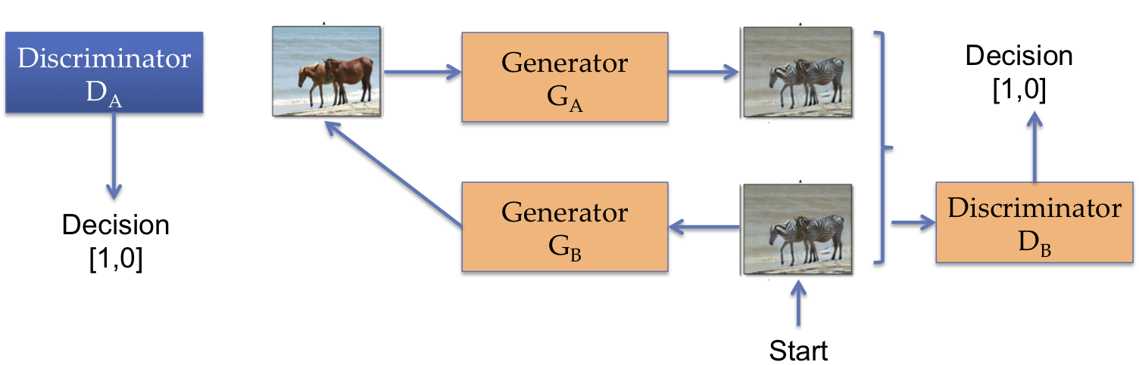
Cycle GAN - Training
First, the generator of the first GAN is trained to generate a target domain image from a source domain image.
The discriminator of the first GAN is trained to identify real target domain images from generated target domain images.
Meanwhile, the generator of the second GAN is trained to generate a source domain image from a target domain image.
The discriminator of the second GAN is trained to identify real source domain images from generated source domain images.

Slide 21
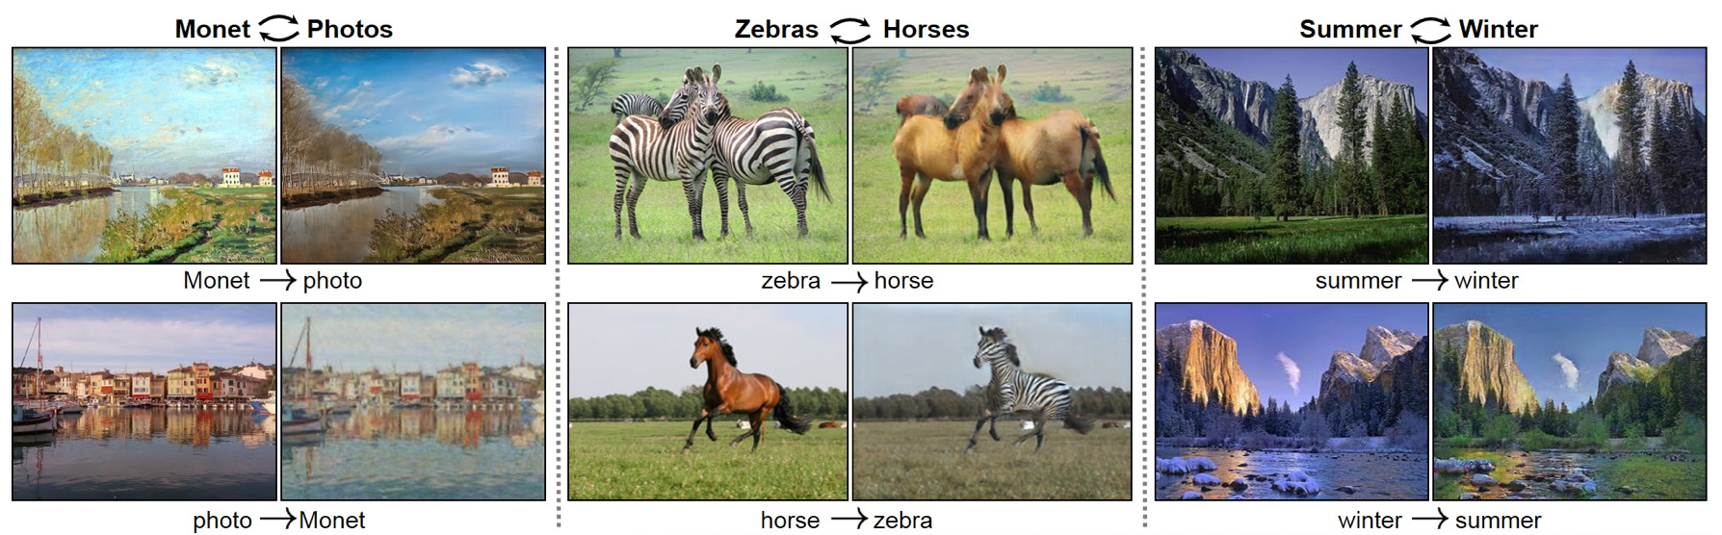
Cycle GAN - Applications
Image-to-image translation: It can be used to translate images from one domain to another. This can be useful for generating training data for machine learning models.
Domain adaptation: This can be used to adapt a model trained on one dataset to another dataset (transfer learning). This is often used to adapt models trained on synthetic data to real data.
Data augmentation: This can be used to generate new data from existing data. This can be useful for increasing the size of a training dataset.
Denoising: This can be used to remove noise from data. This is often used in image and audio applications.

Slide 22
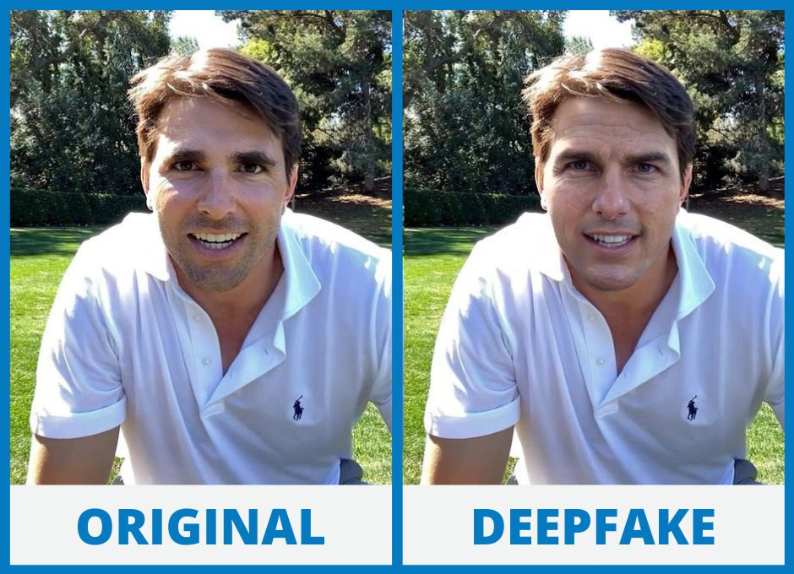
Deep Fake
A deepfake is a synthetic image or video generated by machine learning models to replace one person's likeness convincingly with that of another.
Employing GANs and Cycle-GANs in deepfake generation is very common .
Deepfakes have garnered widespread attention for their potential use in creating fake news, bullying, and financial fraud.
In 2018, the Malicious Deep Fake Prohibition Act was introduced to the US Senate, and in 2019 the DEEPFAKES Accountability Act was introduced in the House of Representatives.

Slide 23
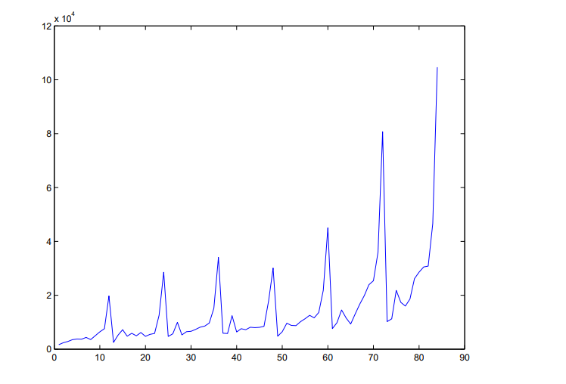
Time Series
A time series is a sequence of data points indexed in time order.
Most commonly, a time series is a sequence taken at successive equally spaced points in time. Thus, it is a sequence of discrete-time data.
Time series types:
Stationarity
Non-stationary
Monthly sales for a shop

Slide 24
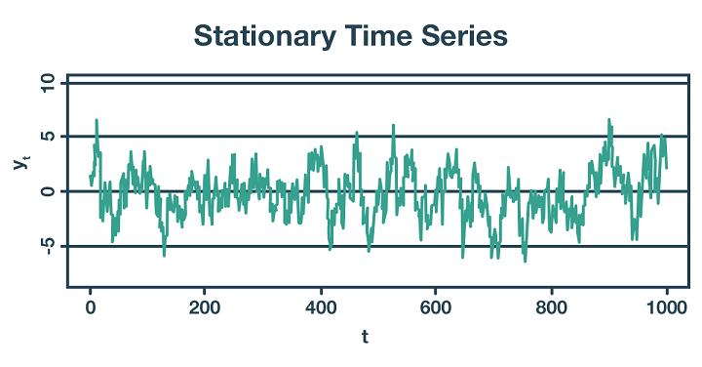
Stationarity Time Series
A stationary process has the property that the mean, variance and autocorrelation structure do not change over time, implying that the probability lies in a particular interval is the same now as at any point in the past or the future.
Prediction on this type of data can be done regardless of previous conditions (e.g., flipping a coin several times)

Slide 25
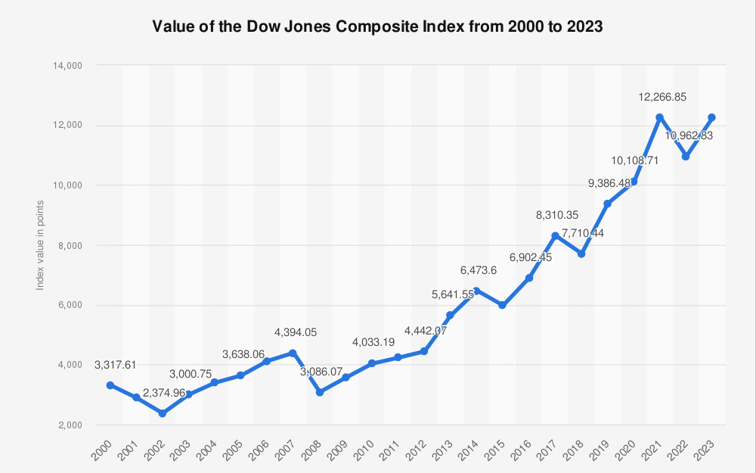
Non-stationary Time Series
In non-stationary timeseries values and associations between and among variables do vary with time.
Prediction on this type of data should consider a sequence of data over time (e.g., sequence of changes in a stock market).

Slide 26
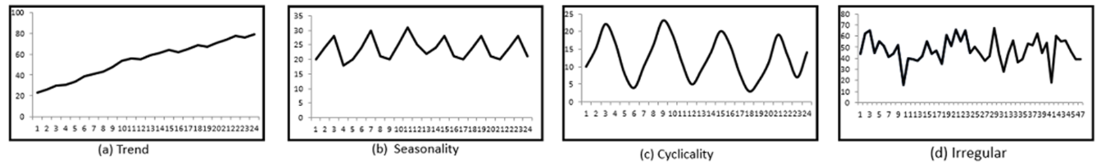
Components of Time Series
In general, any time series may be decomposed into four components:
Trend : increasing or decreasing long term pattern
Seasonal : regular fluctuations during the same time periods
Cyclical: Any pattern showing an up and down movement around a given term
Random: Every time series has some unpredictable component (random variable).

Slide 27
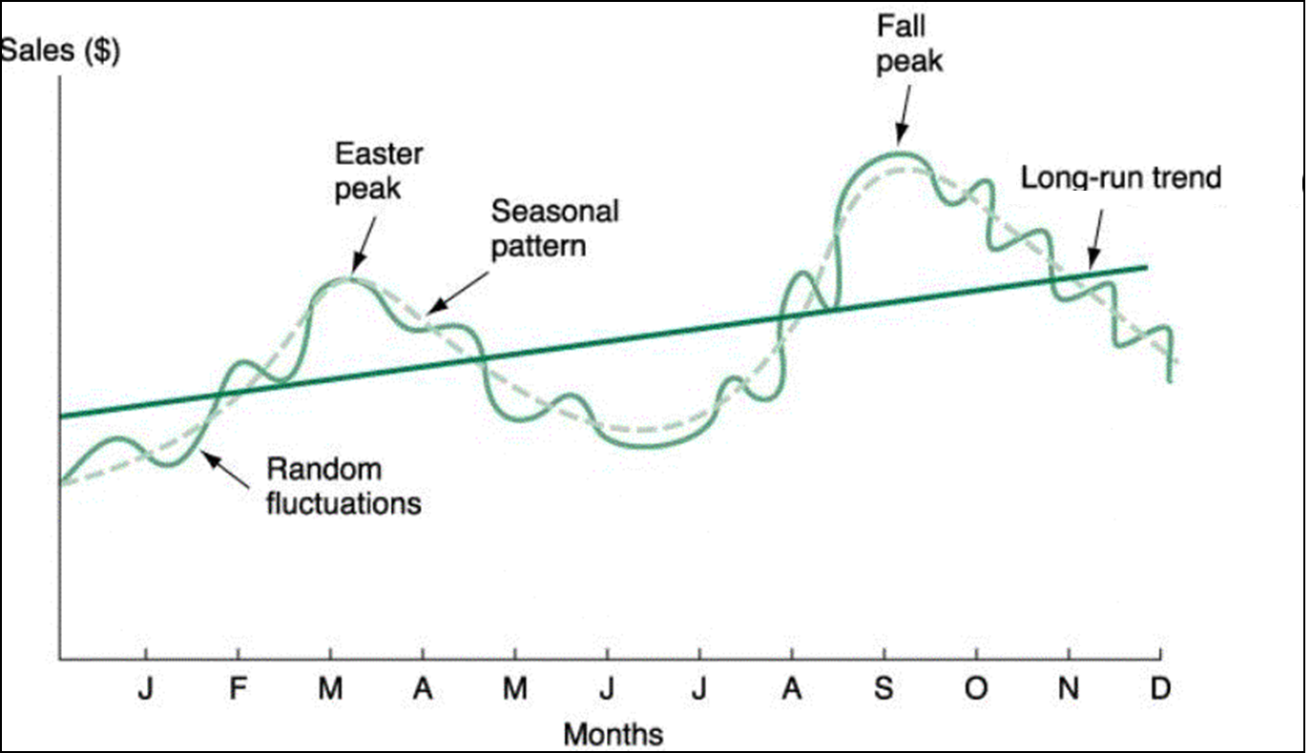
Prediction of Time Series
These components may be combined in different ways. It is usually assumed that they are multiplied or added, i.e., yt = T × C × S × I, yt = T + C + S + I
In prediction, the objective is to model all the components to the point that the only component that remains unexplained is the random component.

Slide 28
Limitations of Feed Forward Neural Networks
Traditional NN are DAGs (Directed Acyclic Graphs). That means they have a topological ordering.
In traditional NN, it is assumed that every input is independent each other but with sequential data, input in current time step is highly likely depends on input in previous time step
We need some additional structure that can model dependencies of inputs over time
Dependent inputs can be represented by a sequence of data
𝑦
𝑉
ℎ
𝑈
𝑥

Slide 29
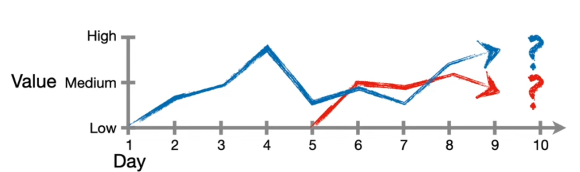
Requirements of Time Series in Neural Networks
In time series not just conditions in a point of time but a sequence of conditions are needed for prediction /classification
Length of sequential data required for a prediction can be different in different applications, datasets or even individual samples

Slide 30
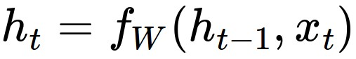
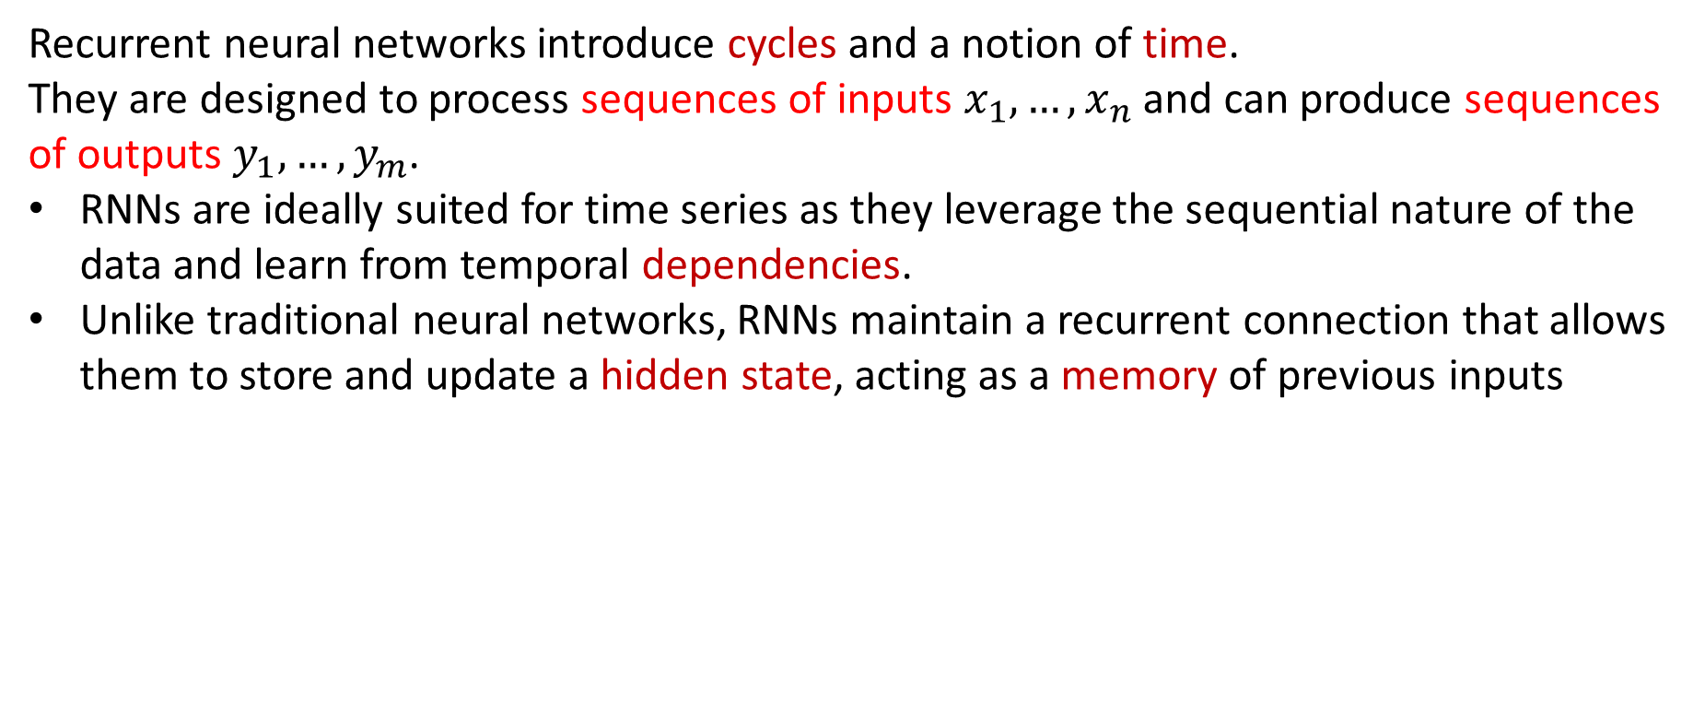
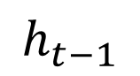
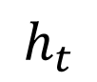
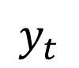
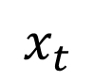
Recurrent Neural Network
Recurrent Neural Networks (RNNs)
Recurrent neural networks introduce cycles and a notion of time.
They are designed to process sequences of inputs $x_{1},…,x_{n}$ and can produce sequences of outputs $y_{1},…,y_{m}$.
RNNs are ideally suited for time series as they leverage the sequential nature of the data and learn from temporal dependencies.
Unlike traditional neural networks, RNNs maintain a recurrent connection that allows them to store and update a hidden state, acting as a memory of previous inputs
$$x_{t}$$
$$y_{t}$$
$$h_{t−1}$$
$$h_{t}$$
new state
old state
some function
with parameters
input vector at some time step
One-step delay

Slide 31

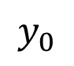
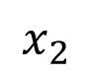
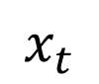
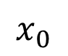
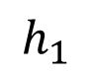
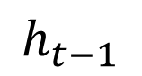
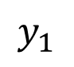
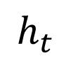
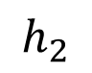
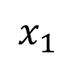
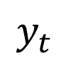
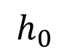
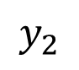
Recurrent Neural Network
Unrolling RNNs
RNNs can be unrolled across multiple time steps.
The size depends on the input sequence length.
Since these steps represent a same function over time the parameters of all step are the same
$$y_{0}$$
$$x_{0}$$
$$h_{0}$$
$$y_{1}$$
$$x_{t}$$
$$y_{t}$$
$$x_{1}$$
$$h_{1}$$
$$h_{t−1}$$
$$h_{t}$$
$$y_{2}$$
$$x_{2}$$
One-step delay
$$h_{2}$$
Parameters to be learned: U, V, W
Same parameters for all time points

Slide 32
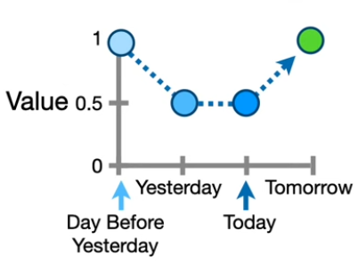
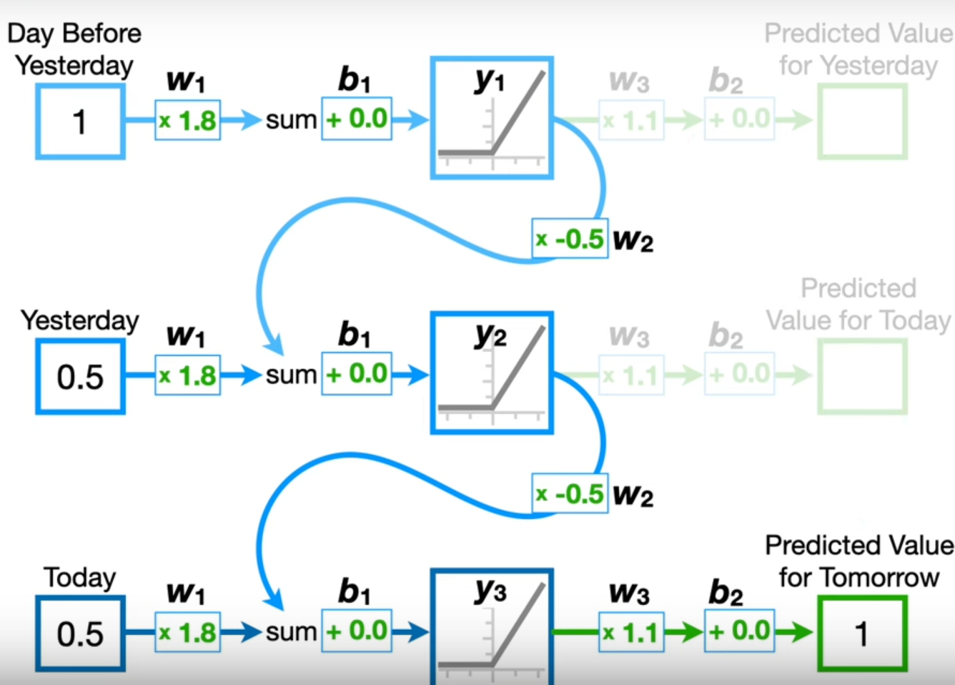
Recurrent Neural Network - Example
H0 = Relu (1 * 1.8 + 0) = 1.8
H1 = Relu (0.5 * 1.8 + 1.8 * -0.5 + 0) = 0
H2 = Relu (0.5 * 1.8 + 0 * -0.5 + 0) * 1.1 = 1

Slide 33

Recurrent Networks offer a lot of flexibility:
Types of Recurrent Neural Networks
e.g. Image Captioning
image -> sequence of words
e.g. Stock Prediction
seq of stock prices -> future stock price
e.g. Machine Translation
seq of words -> seq of words

Slide 34



Sentence Completion using an RNN
Trained Neural Language model can be used to complete a given sequence of words.
Independently choosing the most likely output over a sequence is not a reliable way of arriving at a good output since it doesn’t guarantee that the individual choices make sense together and combine into a coherent whole
The last hidden state of prefix encoded the context of information of all previous states and the last prediction of prefix contains the most likely next word.
$Most probable word=softmax$(V$h_{t}$)
$h_{t}=$g($h_{t−1}$+W${∗x}_{t}$)

Slide 35


Encoder Decoder Networks
Encoder: takes an input sequence and generates a contextualized representation of the inputs.
Context vector: conveys the essence of the input to the decoder.
Decoder: takes the context vector and autoregressively (predict future values based on past ones) generates a sequence of outputs with arbitrary length

Slide 36


Encoder Decoder - Translation Example
Encoder: Trained on the source language sentences to takes an input sentence (sequence of words) in the language and generates a contextualized representation of the sentence.
Decoder: Trained on the target language sentences to autoregressively create statements based on the input context
trained on sentences in first language
trained on sentences in second language
states of previous nodes (short memory)
context (long memory)

Slide 37

Encoder Decoder - Conversation Example
Encoder: Trained on the language sentences to takes an input sentence (sequence of words) in the language and generates a contextualized representation of the sentence.
Decoder: Trained on the responses and autoregressively create statements based on the input context

Slide 38

Exploding and Vanishing Gradient Problem
In backpropagation, the recurrence multiplication of gradients can result in difficulties called exploding and vanishing gradient problem
In vanishing gradients, the gradient of a long-term interaction has exponentially smaller magnitude than the gradient of a short-term interaction therefore, it might take a very long time to learn long-term dependencies
Output = Relu(Relu(Relu(x1*w1) * W2 + x2*W1)* W2 + x3*w1)
W1 = w1 - Learning Rate * $\frac{∂E}{∂w_{1}}$
Rule Chain: $\frac{∂E}{∂w_{1}}$ = $\frac{∂E}{∂output}$ * $…$
$→$ $\frac{∂E}{∂W_{1}} includes$ many multiplications of $W_{2}$ (e.g., ${W_{2}}^{50}$)
If $W_{2}$ is between 0 and 1 then $\frac{∂E}{∂W_{1}}$ would be very small (vanishing)
If $W_{2}$ is bigger than 1 then $\frac{∂E}{∂W_{1}}$ would be very large (exploding)
Error (E)
Real Output

Slide 39


Long Short-term Memory (LSTM)
Capable of modeling longer term dependencies by having memory cells and gates that controls the information flow along with the memory cells
Just like a simple RNN, an LSTM also has a hidden state of the previous timestamp, known as short term memory.
The cell state is known as long term memory carries the information along with all the timestamps.

Slide 40

Long Short-term Memory (LSTM)
The contents of the memory cells are regulated by various gates:
Forget gate: how much contents from previous cell will be erased
Input gate: how much of input value is combined into the cell states
Output gate: which part of cell state will be in the output
Each gates are composed of transformation with Sigmoid activation function

Slide 41

Real-life Challenges in Deep Learning Tasks
Deep learning methods are data-hungry
Labeled data in the target domain may be limited
In some cases, this problem can be addressed with transfer learning

Slide 42

Transfer Learning Approaches
Transfer learning is a technique in which knowledge learned from a task is re-used on a related task
In Transfer Learning, source data is not directly related to the target task

Slide 43

Model Fine-tuning
Training a model by source data, then fine-tune the model by target data
Source data: A large amount of labeled data
Target data: A small amount of labeled data
e.g., in CNN:
Source data: images of different objects
Target data: images of a specific object

Slide 44
Conservative Training
Select a model trained on the source data. Use a same architecture for the target network with parameters (weights and biases) of the source neural network as initial weights which will be trained in the next step using the target dataset.
Similar outputs
Initialization of parameters
Source data
Target data

Slide 45

Layer Transfer
Select a model trained on the source data and copy some layers.
Freeze these layers during training (no change) and just train the rest layers using target data
Unfreeze these layers and fine-tune whole network with smaller learning rate (smaller changes in weights) on target data

Slide 46

Selection of Layers for Transfer
Depends on architecture of neural network and domain:
CNN: first convolutional layers are general learners which detect low-level notions of edges, visual shapes and last layers are specific learners which features such as eyes, feathers. Therefore, usually, the first few layers are the best to transfer
Bird, Cat, Dog, ...
Edges, Rounds, ..
Beak, Belly, ..
Structures of Bird, Cat, Dog, ...

Slide 47

Shared Feature Extractor
We can use a pre-trained model on a large dataset (source) as a feature extraction mechanism. Then, we can remove the output layer and use the entire network as a fixed feature extractor for the new data set with a new output layer.
This approach is Inspired by the success of models pre-trained on ImageNet in Computer Vision
ImageNet is an image database organized according to the WordNet hierarchy, in which each node of the hierarchy is depicted by hundreds and thousands of images.

Slide 48

Training using Back-propagation
In first training process on target data backpropagation starts from output and updates the layers except frozen layers.
In fine-tuning process all the layers are trained using during backpropagation using a smaller learning rate
For fine tuning a smaller learning rate is used to avoid large changes in weights of pretrained model. E.g., 10% of the original learning rate can be used in finetuning of first layers, and 1% of the original learning rate can be used on intermediate layers.

Slide 49
Fine-tuning Strategies
Usually, fine tuning is preferred when target dataset is relatively small, but regarding type of neural network, size of target dataset. and similarity between source and target dataset different strategies can be applied.
E.g., for CNN:
Target dataset size | Dataset similarity | Recommendation
Large / Medium | Very different | Train target model from scratch, use the architecture and initialize weights from the source model
Large / Medium | Similar | Transfer first layers of source and froze the rest during training target then fine-tune whole model
Small | Very different | Don't fine-tune
Small | Similar | Use feature extractor of a pre-trained model and train a classifier using target data, then fine-tune the model

Slide 50

Multi-Task Learning
In Multi-Task Learning (MTL) a model is trained to perform multiple tasks simultaneously. In deep learning, MTL refers to training a neural network to perform multiple tasks by sharing some of the network’s layers and parameters across tasks.
In MTL, the goal is to improve the generalization performance of the model by leveraging the information shared across tasks.

Slide 51
Hard Parameter Sharing
Common hidden layers are shared for all tasks, while keeping several task-specific layers.
Task A
Task B
Task A
Task B
Input feature
Input feature for task A
Input feature for task B

Slide 52




Training Shared Layers
During training shared layers, we can add losses of different tasks to calculate loss for shared layers.
If the scale of losses are so different, one task dominates the overall loss and training process.
By replacing the sum of losses with a weighted sum, we can adjust scales.
E=$\frac{1}{2}(Traget−Output)^{2}$
E1=$\frac{1}{2}(Traget1−Output1)^{2}$
E2=$\frac{1}{2}(Traget2−Output2)^{2}$

Slide 53


Soft Parameter Sharing
Each model has their own sets of weights and biases but the distances between these parameters in different models are constrained / regularized in order to encourage the parameters to be similar and can represent all the tasks

Slide 54
Multi-Task Learning - Considerations
MTL is most effective when the tasks are related or have some commonalities, such as natural language processing, and computer vision.
When the tasks are completely independent, MTL can lead to suboptimal performance compared to training a single-task model. Therefore, it is important to make sure that the shared features are useful for all tasks to avoid negative transfer.
The architecture of MTL should be carefully designed to accommodate the different tasks and to make sure that the shared features are useful for all tasks.

Slide 55


MTL Applications
Object Recognition and Computer Vision : e.g., object detection and facial recognition together
Self Driving Cars: e.g., pedestrians, stop signs and other obstacles can be detected together
Multiple Prediction: e.g., Multiple Stock Prediction

Slide 56

Progressive Neural Networks
Forgetting can occur within a trained neural net during fine-tuning when important parameters within the network are changed to fit the new data, compromising the network’s ability to handle the old data.
Progressive neural networks can expand their topology to incorporate new knowledge while preserving the original parameters for later use.

Slide 57



Training Process
Training first (initial column) neural network to perform the first task then the weights are frozen, thus forgetting optimal weights for the first task is impossible.
The outputs of layer L in the last network(s) becomes additional inputs to layer L+1 in the new column of neural network. The new column is initialized with random weights and trained for the next task. After training the weights are frozen, thus forgetting optimal weights for this task is impossible.
Repeat step 2 for other tasks.

Slide 58

Progressive Neural Networks - Advantages
During Training, each layer learns which information sources are most effective for carrying out its task.
If it finds that some outputs from last models have all the information it needs, it can zero-out the other inputs.
If it finds that the new task needs specific weights or some tuning of the weights it can set its own weights.
All model are specialized for their target domain also take advantage of other domains
This can be a good strategy when there is lots of data in the pre-training source domain, and not so much in the target domain

Slide 59

Domain-Adversarial Training
In domain-adversarial training, a neural network model is trained to simultaneously perform the primary task while being encouraged to learn features that are invariant across other domains (general features).

Slide 60





Domain-adversarial Training - Example

Slide 61


Domain-adversarial Training
Maximize label classification accuracy + Minimize domain classification accuracy
Maximize label classification accuracy
feature extractor
Label predictor
Domain classifier
Not only cheat the domain classifier, but satisfying label classifier at the same time
Maximize domain classification accuracy

Slide 62

Domain-adversarial – Back Propagation
The network is trained using back-propagation on two loss functions
Ideally, domain classifier fails in the end and cannot discriminate which features belongs to each domain (for two tasks the accuracy will be 0.5)
Try to minimize label classification loss function
Try to minimize label classification loss function
+ maximize domain classification loss function
Try to minimize domain classification loss function

Slide 63

Zero-shot Learning
In Zero-shot learning (ZSL) a model is trained to recognize or perform tasks on classes or domains that it has never seen during the training phase by leveraging auxiliary information or semantic embeddings about those classes.

Slide 64



Semantic Embeddings
Each class or domain is associated with semantic descriptions, attributes, word embeddings, or other forms of auxiliary information. These embeddings encode high-level semantic features that describe the characteristics of each class, allowing the model to understand the relationships between classes even if it has not seen examples from all of them during training.
attributes
 | furry | 4 legs | tail | …
Dog | 1 | 1 | 1
Fish | 0 | 0 | 1
Chimp | 1 | 0 | 0
…
class

Slide 65
Model Architecture
The model is designed to incorporate both visual features (in tasks such as image classification) and semantic embeddings. This allows the model to learn a mapping between visual features and semantic space, enabling it to make predictions for unseen classes based on their semantic descriptions.
furry
4 legs
tail
attributes
 | furry | 4 legs | tail | …
CNN Model
Input Image

Slide 66
Zero-shot Learning – Training Model
The model is trained to extract features using samples in the training dataset and classify based on semantic embeddings.
1
0
0
1
1
1
 | furry | 4 legs | tail | …
Dog | 1 | 1 | 1
Fish | 0 | 0 | 1
Chimp | 1 | 0 | 0
…
Output of model:
Chimp Dog
furry
4 legs
tail
furry
4 legs
tail
CNN
CNN
Using real labels of training data and output of the model, loss will be calculated during training and weights are adjust using backpropagation process
Label: Chimp
Label: Dog

Slide 67
Zero-shot Learning - Inference
On unseen data during training, the model selects the class with the most similarity to the attributes detected in the image
0
0
1
 | furry | 4 legs | tail | …
Dog | 1 | 1 | 1
Fish | 0 | 0 | 1
Chimp | 1 | 0 | 0
…
Output of model:
Fish
furry
4 legs
tail
CNN
Sometimes only part of features are aligned, in such cases we can use Bayesian inference to select class with maximum likelihood

Slide 68

Graph-based Zero-shot Learning
Graph-based approaches to Zero Shot Learning involve constructing a graph / ontology where nodes represent the classes and edges represent the semantic relationships between them. This allows the model to make predictions about unseen classes based on their relationships with seen classes.

Slide 69
Application of Zero-shot Learning
Object Recognition and Computer Vision : e.g., unknown object detection in autonomous vehicles
Medical Diagnostics and Healthcare : e.g., unforeseen diseases in medical imaging
Robotics and Human-Computer Interaction: e.g., a robot can understand a new command by associating it with known commands with similar meanings.
Generative Models: e.g., create images that goes beyond their training sets, significantly expanding their capabilities

